Slide 1
Network Analysis Final Project
Oishiq Nandy
Meghna Nayal
Yamini Nayal

Slide 2
Epidemic Models
Answers questions about how to handle the spread of a disease.
Commonly used epidemic models: SIR, SEIR and SIRS.
Simulation on a closed knit community of 1000 people.

Slide 3
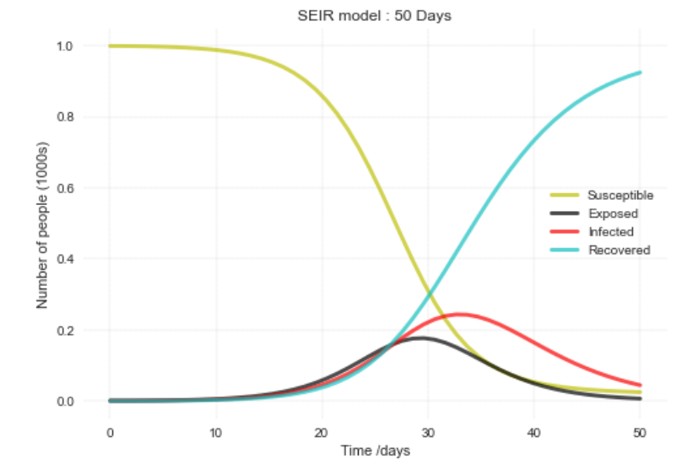
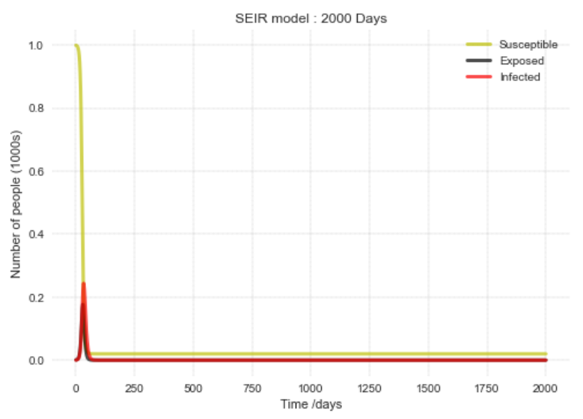
Simulation – SEIR
We approached our epidemic with the help of the SEIR model
Alpha – Rate of contact
Beta – Rate of Transmission
Infection Period - 5 days
Stays immune forever after infection period is over.

Slide 4
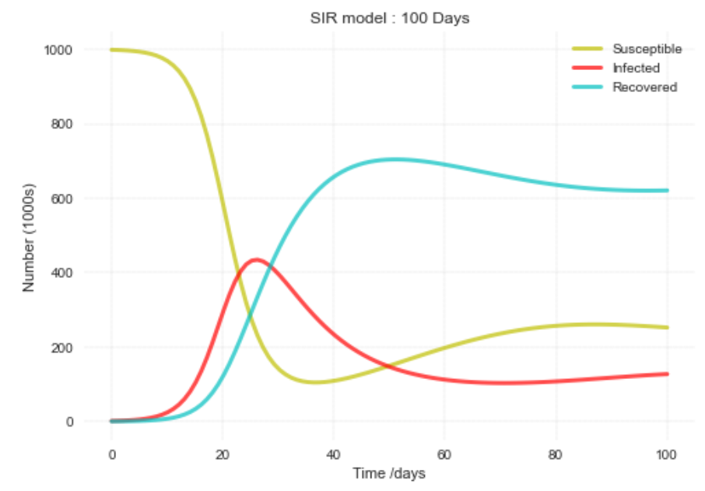
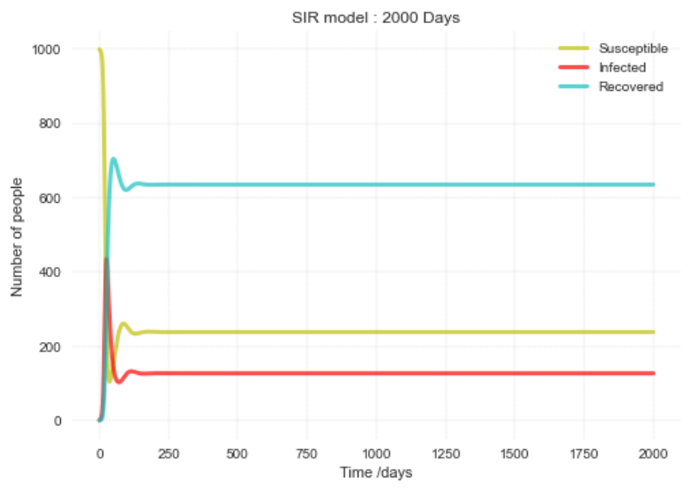
Simulation – SIRS
We now test immunity with the help of the SIRS model.
Infection Period - 5 days
Loss of Immunity – After 20 days
May or may not get the infection again.

Slide 5

Comparing $R_{O}$ in Different Situations
R0 is a parameter describing the average number of new infections due to a sick individual.
R0 in SEIR Model – 4
R0 in SIRS Model - 7.
The epidemic ceases to exist once R0 < 1 .

Slide 6
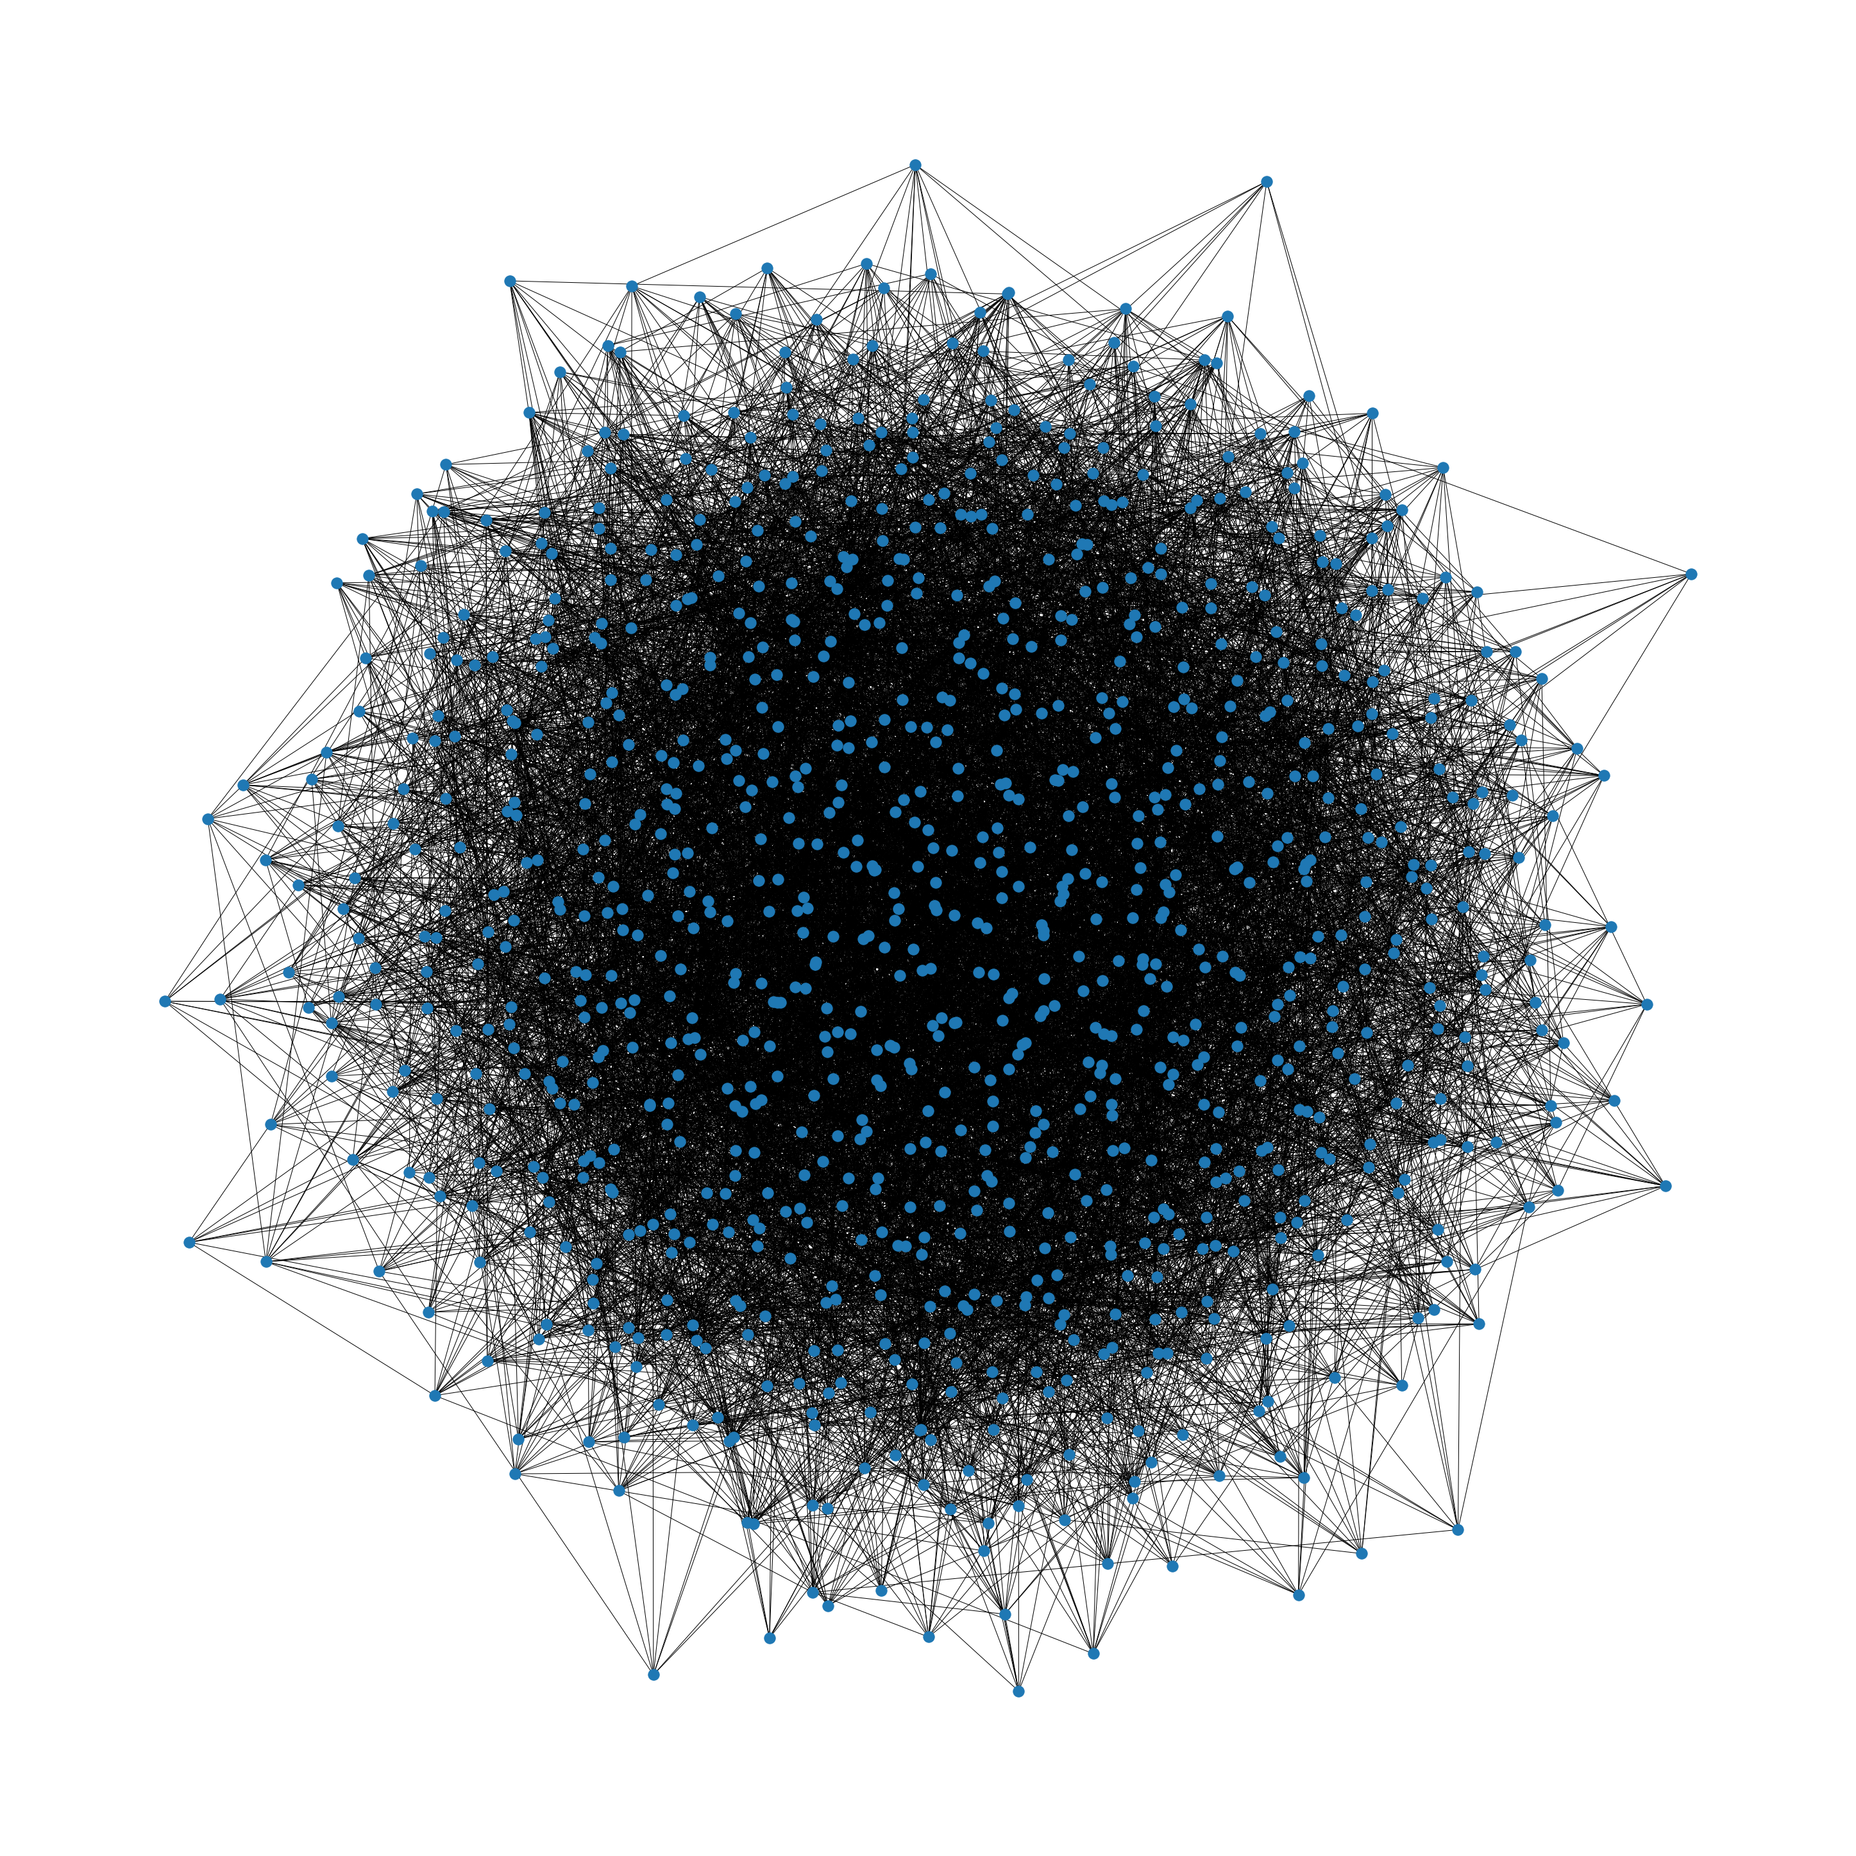
Random Graph
We repeat the simulation again, but now on a random graph.
Edge Probability – 0.02

Slide 7
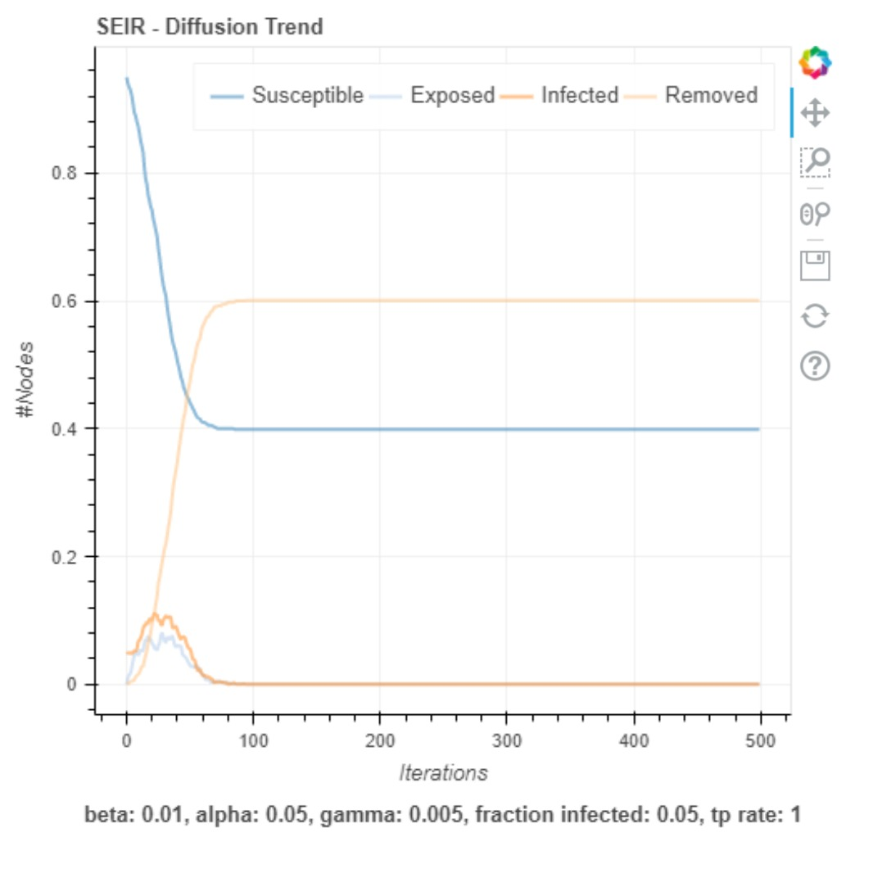
Random Graph
The number of people exposed to virus keeps fluctuating.
Similarly, the number of people infected by the virus keeps fluctuating.
Once everyone has attained “herd immunity” the epidemic gets wiped out.

Slide 8
Simulating a Concert
Assuming, there is a concert happening in our city and few of the attendees are infectious.
We visualize how the event accelerates the spread of virus.
Also visualize how long it takes for the community to recover from this event.

Slide 9
Simulating a Concert

Slide 10
Questions?

